Slide 1


Department of Artificial Intelligence and Data Science
Agriculture – Precision Farming with IoT Sensor Streams
Done By:
Akshayaa S-231801007
Amala Encilin T-231801009
Hannah James - 231801047
Dr.S.Suresh Kumar
Prof.AI&DS

Slide 2
INTRODUCTION
Modern agriculture is rapidly transforming with the integration of Internet of Things (IoT) and Big Data analytics, enabling smarter, more efficient, and sustainable farming practices.
Our project, “Precision Farming with IoT Sensor Streams,” aims to harness real-time sensor data to monitor critical environmental parameters such as soil moisture, temperature, humidity, pH, and rainfall.
The goal is to analyze this continuous data flow using powerful Big Data technologies — Hadoop for storage, Spark for processing, and Hive for querying.
By transforming raw IoT data into actionable insights, the system can provide recommendations for irrigation, predict soil conditions, and assist farmers in making timely, data-backed decisions.
This project demonstrates how digital technologies can increase crop yield, optimize resource utilization, and promote sustainable agriculture, bridging the gap between traditional farming and modern data-driven solutions.

Slide 3
ABSTRACT
The project “Precision Farming with IoT Sensor Streams” integrates IoT technology and Big Data analytics to revolutionize agriculture.
IoT sensors continuously collect real-time data on soil moisture, temperature, humidity, pH, and rainfall.
This data is processed through a Big Data pipeline built using Hadoop for storage, Spark for data processing, and Hive for querying and analysis and the visual insights are been delivered.
The system enables farmers to optimize irrigation schedules, reduce resource wastage, and enhance crop yield and sustainability.
The project demonstrates the potential of combining IoT and data analytics to drive smart, sustainable, and efficient agriculture.

Slide 4
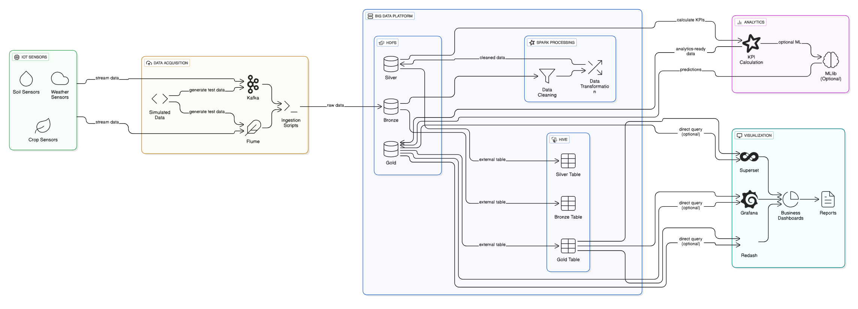
ARCHITECTURE DIAGRAM

Slide 5
ARCHITECTURE DIAGRAM-MODULES
IoT Sensors Layer
Data Acquisition Layer
Analytics Layer
The foundation of the system is the IoT Sensor Network, which collects environmental and crop related data from the field. These sensors serve as the entry point for the entire data pipeline.
COMPONENTS
1. Soil Sensors
2. Weather Sensors
3. Crop Sensors
Functions: These sensors generate continuous streaming data representing real-world agricultural conditions. The data is transmitted in near real time to the Data Acquisition Layer for further ingestion.
Purpose : To provide raw, high-frequency, time-stamped data essential for precise decision-making in irrigation, fertilization, and yield management.
The Data Acquisition Layer is responsible for collecting and simulating IoT sensor streams before pushing them into the Big Data ecosystem. This layer ensures a seamless and reliable data flow.
COMPONENTS
1. Apache Kafka
2. Apache Flume
3. Ingestion Scripts
Functions: Data from sensors (or simulated sources) is streamed to Kafka/Flume topics, where it’s temporarily buffered and then written to HDFS Bronze Layer as raw files.
Purpose : To handle both batch and real-time data ingestion efficiently, ensuring no data loss and maintaining scalability for large-scale sensor networks.
The Analytics Layer extracts intelligence from processed data by computing Key Performance Indicators (KPIs) and applying machine learning models for predictive analysis.
COMPONENTS
1. KPI Calculation Module
2. Spark MLlib
Functions: Processes the Gold Layer data using statistical and ML models to derive patterns, predictions, and correlations relevant to precision farming.
Purpose : To move from descriptive analytics (what happened) to predictive insights (what will happen) — improving agricultural decision-making.

Slide 6
ARCHITECTURE DIAGRAM-MODULES
Visualization Layer
Big Data Platform Layer
This layer transforms analytical results into interactive dashboards and visual summaries for decision-makers such as farmers, agronomists, and policy planners.
TOOLS
1. Apache Superset
2. Grafana
3. Redash
Functions: These tools connect to Hive tables or Spark outputs to display Real-time soil moisture and humidity trends Irrigation requirement forecasts, Crop health monitoring charts , Fertilizer schedule recommendations
Purpose :To provide business-level insights and visual summaries, turning complex data pipelines into intuitive dashboards that support data-driven farming decisions..
HIVE
SPARK
HDFS
HDFS is the backbone of data persistence in the pipeline. It organizes data into three logical layers to maintain a structured data lifecycle.
Layers:
Bronze Layer
Silver Layer
Gold Layer
Function: HDFS provides storage for large datasets,batch processing and querying
Purpose : To create a layered data lake architecture.
Apache Hive provides a data warehouse interface to HDFS, allowing SQL-like queries (HiveQL) on top of large datasets.
Components
Bronze Table
Silver Table
Gold Table
Function: Hive enables analysts to query, filter, and aggregate sensor data efficiently.
Purpose : To allow structured access to unstructured data.
Apache Spark performs data processing, transformation, and machine learning tasks on top of HDFS and Hive data.
Functions
Data Cleaning
Data Transformation
Aggregation
Purpose :To create an efficient ETL (Extract–Transform–Load) workflow that transforms massive raw data into structured, actionable insights.

Slide 7
ARCHITECTURE DIAGRAM-WORK FLOW
IoT Sensors
Captures the data such as the soil, weather data
Kafka/Flume
Ingests continous sensor streams
HDFS
Stores the raw data,and the Sparks cleans and transform the data
Hive
  visualize final results for decision-making.
  Processed data is aggregated into Gold Layer and made queryable via Hive.
Grafana

Slide 8
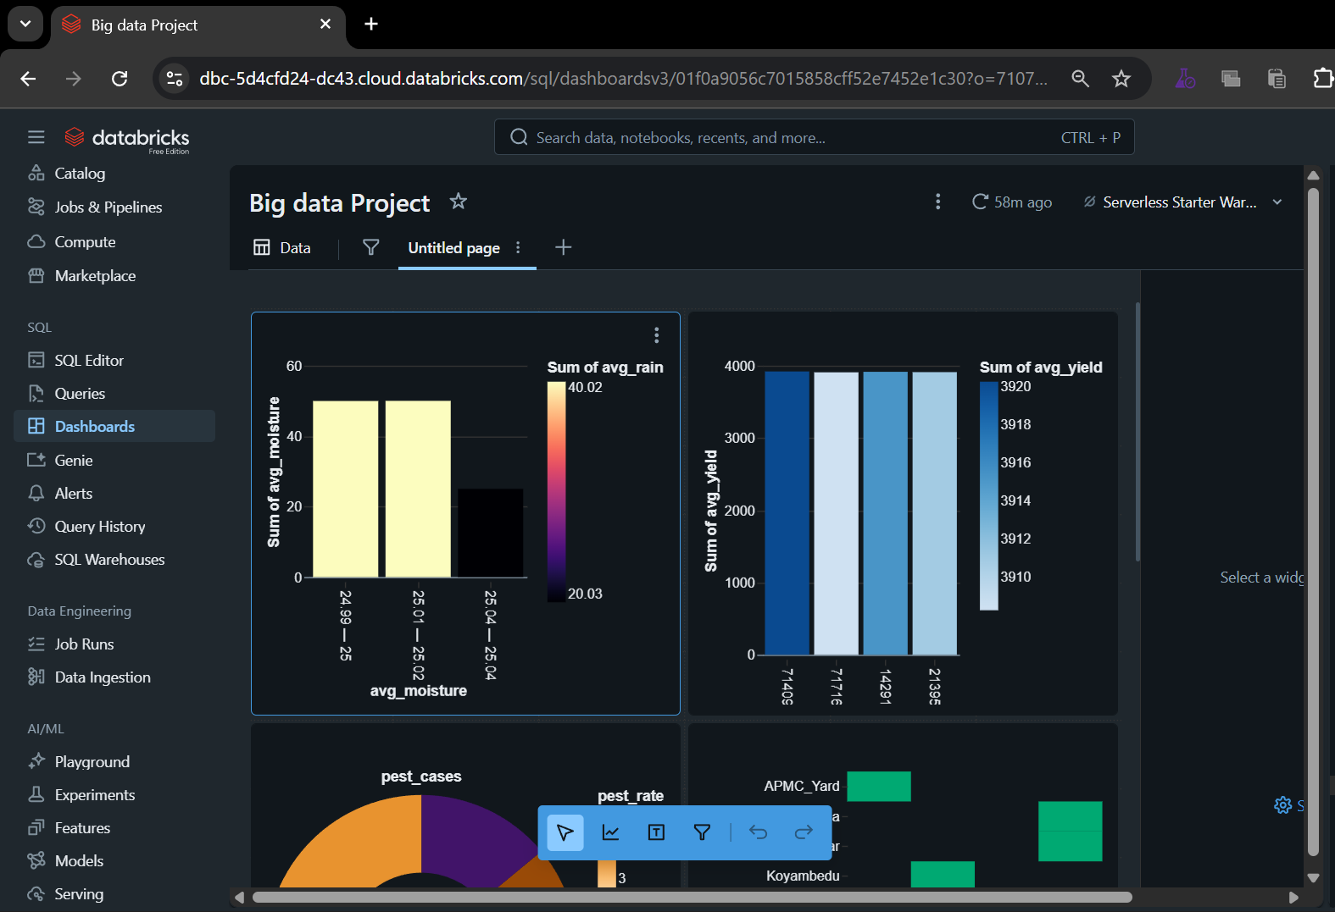
RESULT

Slide 9
FUTURE AND CONCLUSION
CONCLUSION:
The Precision Farming with IoT Sensor Streams project successfully demonstrates how Big Data technologies like Hadoop, Spark, Hive, and Kafka can be used to transform traditional farming into a data-driven, intelligent, and sustainable system.
By integrating IoT-based sensors that continuously collect soil, weather, and crop data, the pipeline enables:
Real-time monitoring of field conditions
Automated data ingestion and processing through the Hadoop ecosystem
Actionable analytics using Spark and Hive
Interactive visualization dashboards providing insights on irrigation
FUTURE ENHANCEMENT:
Real-Time Decision Systems
Cloud Integration
Mobile / Web Application for Farmers
Machine Learning & AI Integration

Slide 10
REFERENCES
https://www.researchgate.net/publication/379596402_Roles_of_Iot_big_data_and_machine_learning_in_precision_agriculture_a_systematic_review.
https://www.mdpi.com/2073-4395/13/10/2603
https://www.researchgate.net/publication/336628540_Research_on_the_Application_of_Agricultural_Big_Data_Processing_with_Hadoop_and_Spark
https://journalofbigdata.springeropen.com/articles/10.1186/s40537-023-00729-0
https://journalofbigdata.springeropen.com/articles/10.1186/s40537-025-01253-z

